Slide 1
PROBLEM STATEMENT
A Microfinance Institution (MFI) is an organization that provide Microfinance Services (MFS) to low income populations. MFS helps poor families who is having less source of income and who lives in remote areas. The Microfinance services provided by Microfinance Institution includes services like Group Loans, Agricultural Loans, Individual Business Loan and so on.
Though, the MFI industry is primarily focusing on low income families and are very useful in such areas, the implementation of MFS has been uneven with both significant challenges and successes.
Today, microfinance is widely accepted as a poverty-reduction tool, representing $70 billion in outstanding loans and a global outreach of 200 million clients.
MFI is working with Telecom Industry who is dealing with fixed wireless telecommunications network provider. They have launched various products and have developed its business and organization based on the budget operator model, budget operator model, offering better products at Lower Prices to all value conscious customers through a strategy of disruptive innovation that focuses on the subscriber.

Slide 2
PROBLEM UNDERSTANDING
A Microfinance Institution understand the importance of communication and their impact on person’s life, thus focusing on providing their services and products to low income families and poor customer that can help them in the need of hour.
So, its very important to chooses their customer for the credit, they need some predictions that could help them in further investment and improvement in selection of customer.
Identifying the default customer is very important step to improve their business and targeting right segment of customer.
Here, if the customer is deviates from the path of paying back the loaned amount within 5 days, then the customer will classify as defaulter. For the loan amount of 5 (in Indonesian Rupiah), payback amount should be 6 (in Indonesian Rupiah) and for the loan amount of 10 (in Indonesian Rupiah), the payback amount should be 12 (in Indonesian Rupiah).
Here the main objective would be building some model which would help them to select the customer for credit and also to identify most important features which will classify customer as defaulter or not.
We have here 2 class 0 and 1 where class ‘1’ indicates that the loan has been payed i.e. Non- defaulter, while, Label ‘0’ indicates that the loan has not been payed i.e. defaulter.

Slide 3
EDA STEPS ,VISUALIZATIONS,FINALIZED MODEL AND CONCLUSION
Variable identification.
Statistical Summary of Features data.
Graphical Analysis.
Dealing with Imbalanced Target Variable
Principal Components Analysis
Model Development and Evaluation
Conclusion

Slide 4
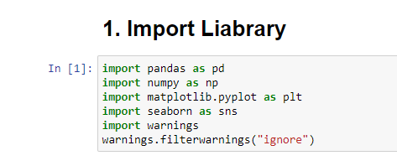
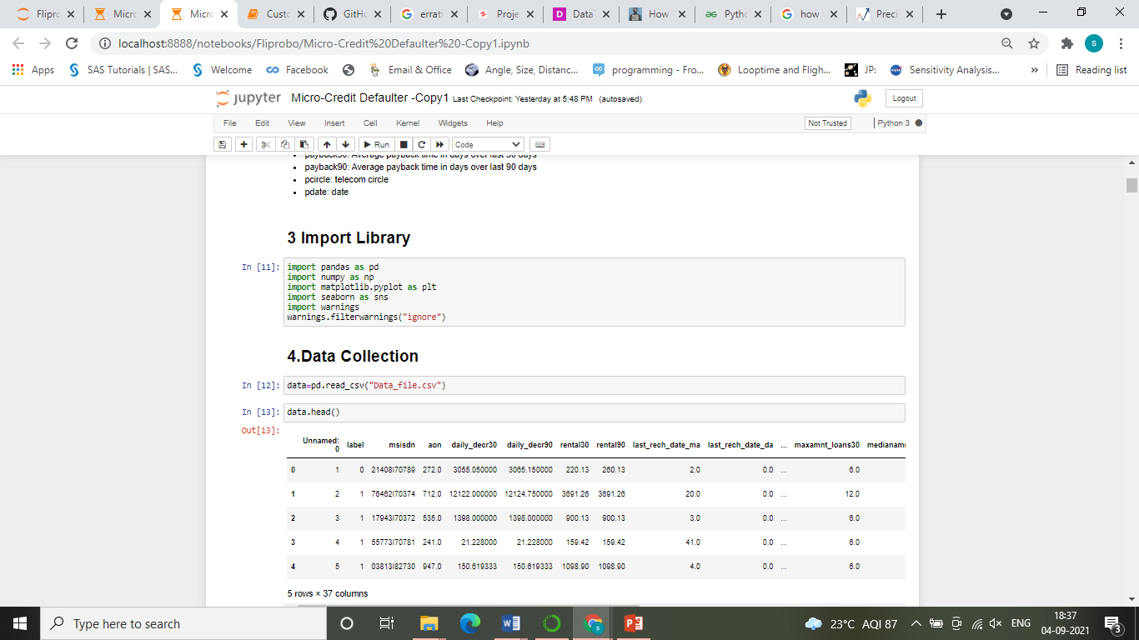
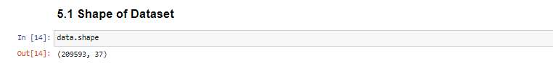
Variable identification.
Importing Libraries:
Importing Dataset:
Size of the dataset:

Slide 5
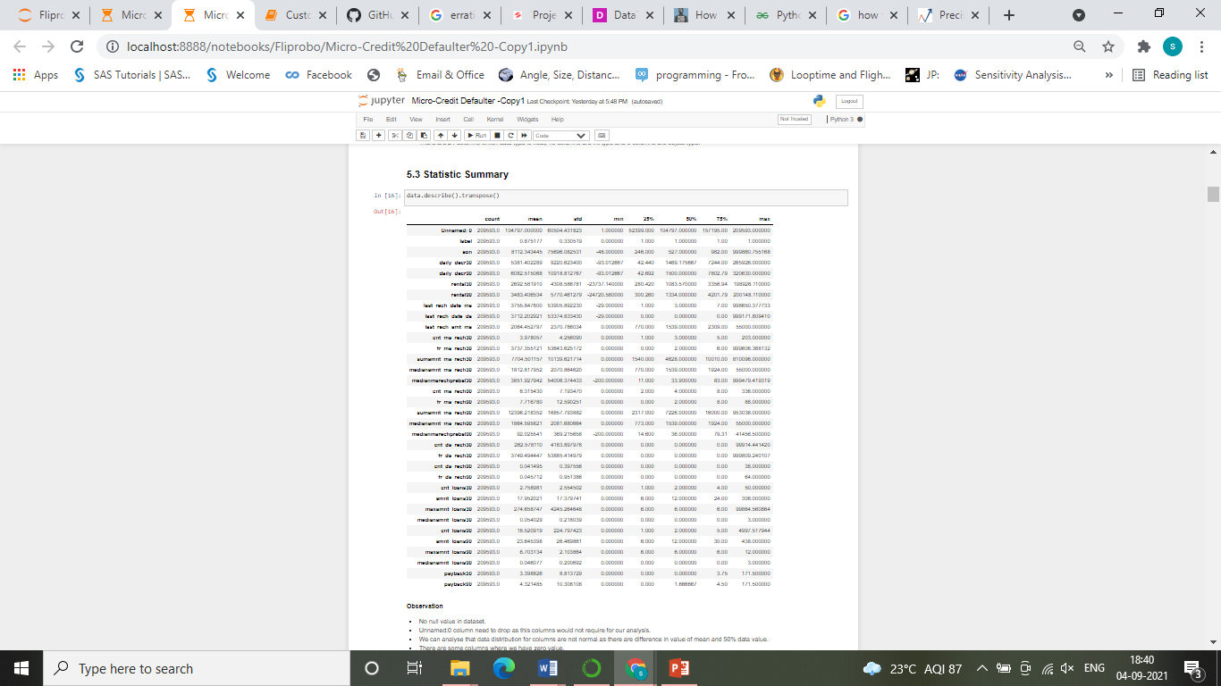
Statistical Summary of Features data.

Slide 6
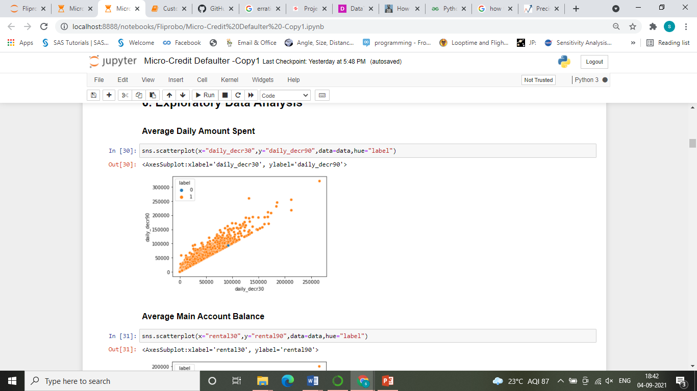
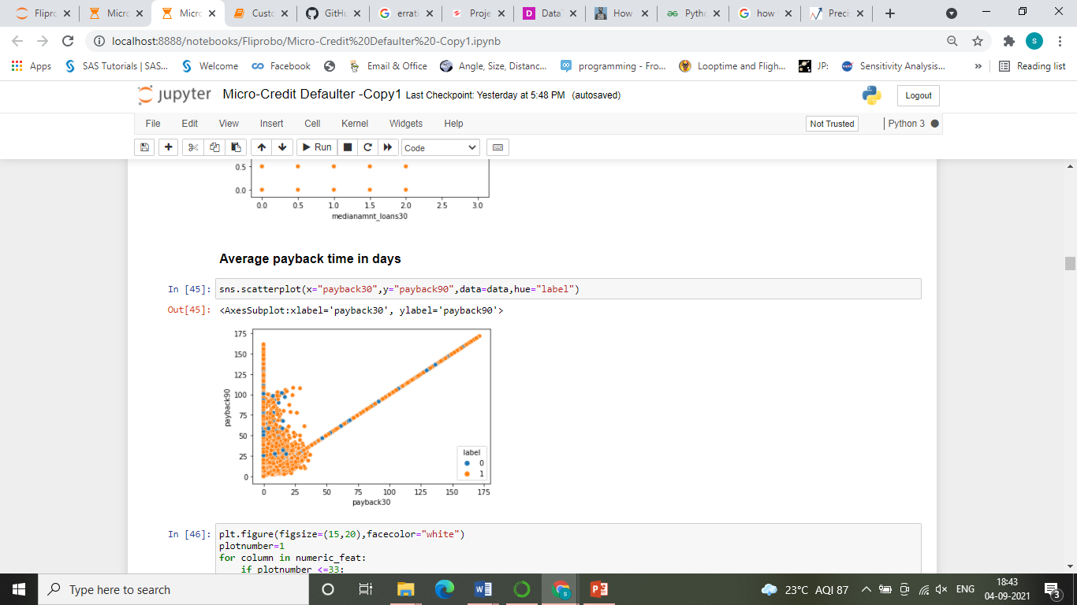
Graphical Analysis.

Slide 7
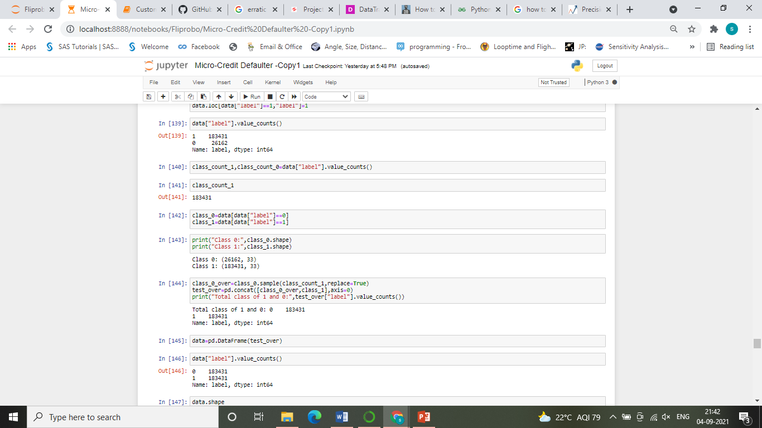
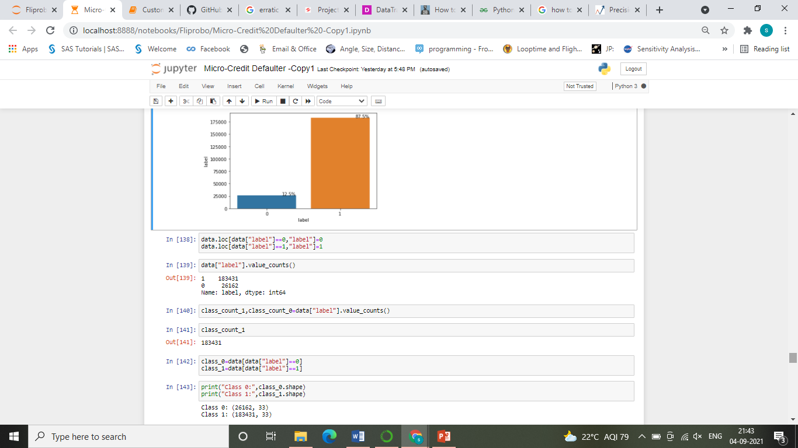
Dealing with Imbalanced Dataset

Slide 8
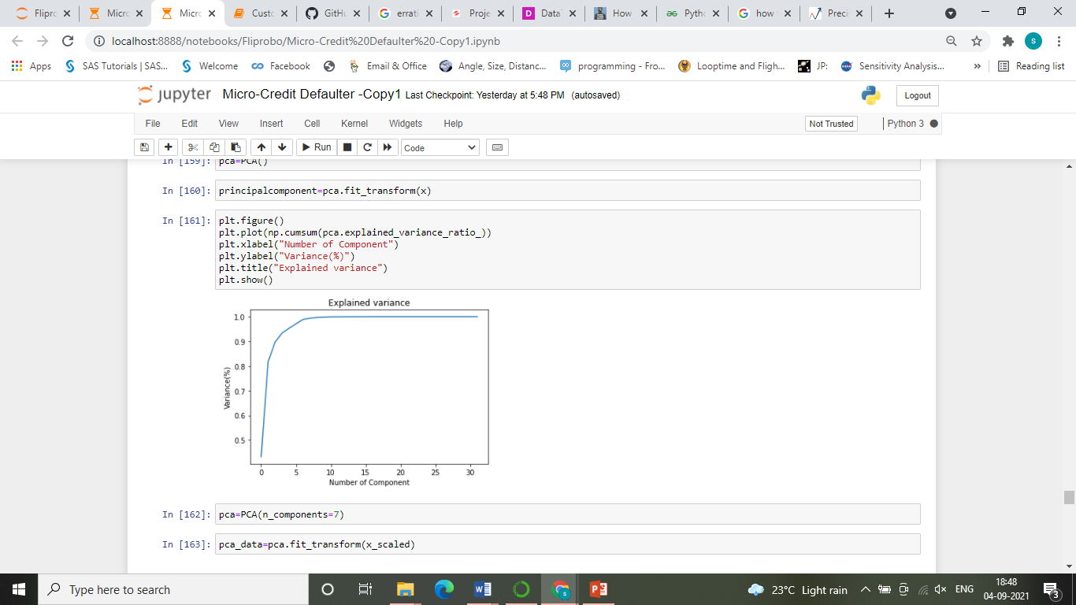
Principal Components Analysis

Slide 9
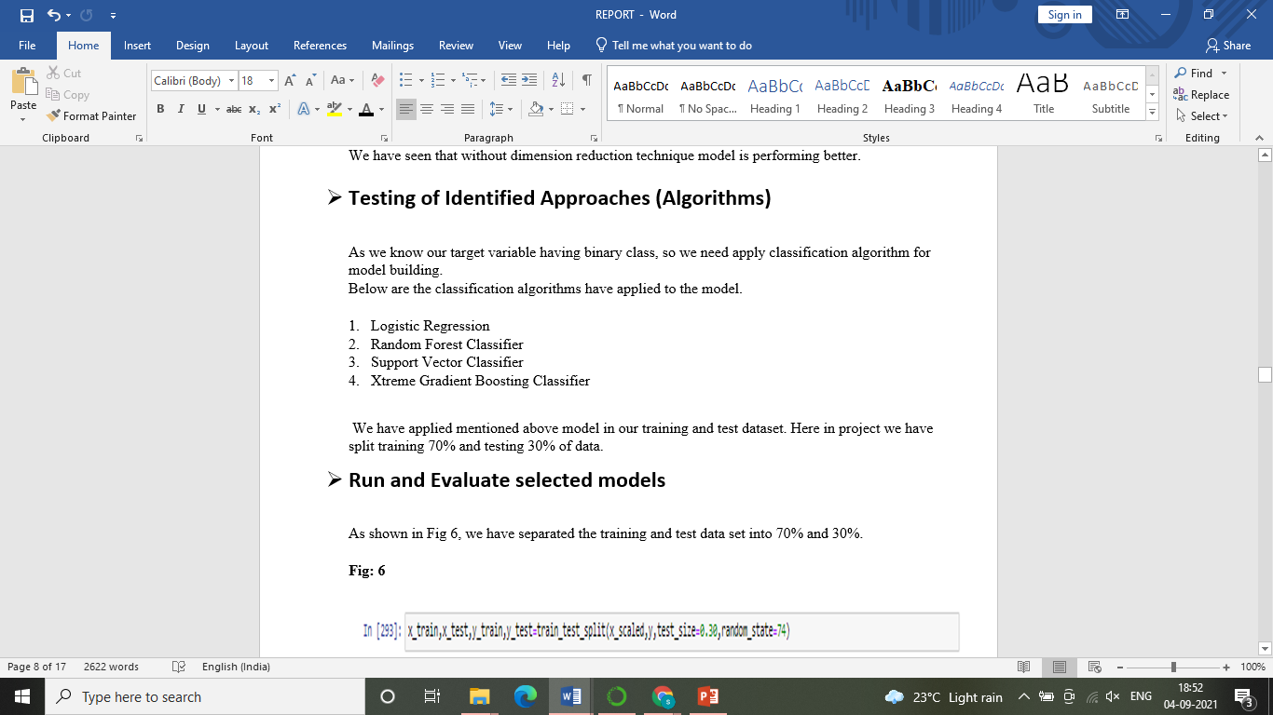
Model Development

Slide 10
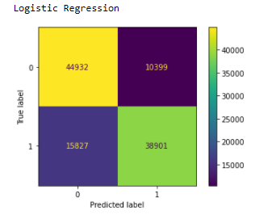
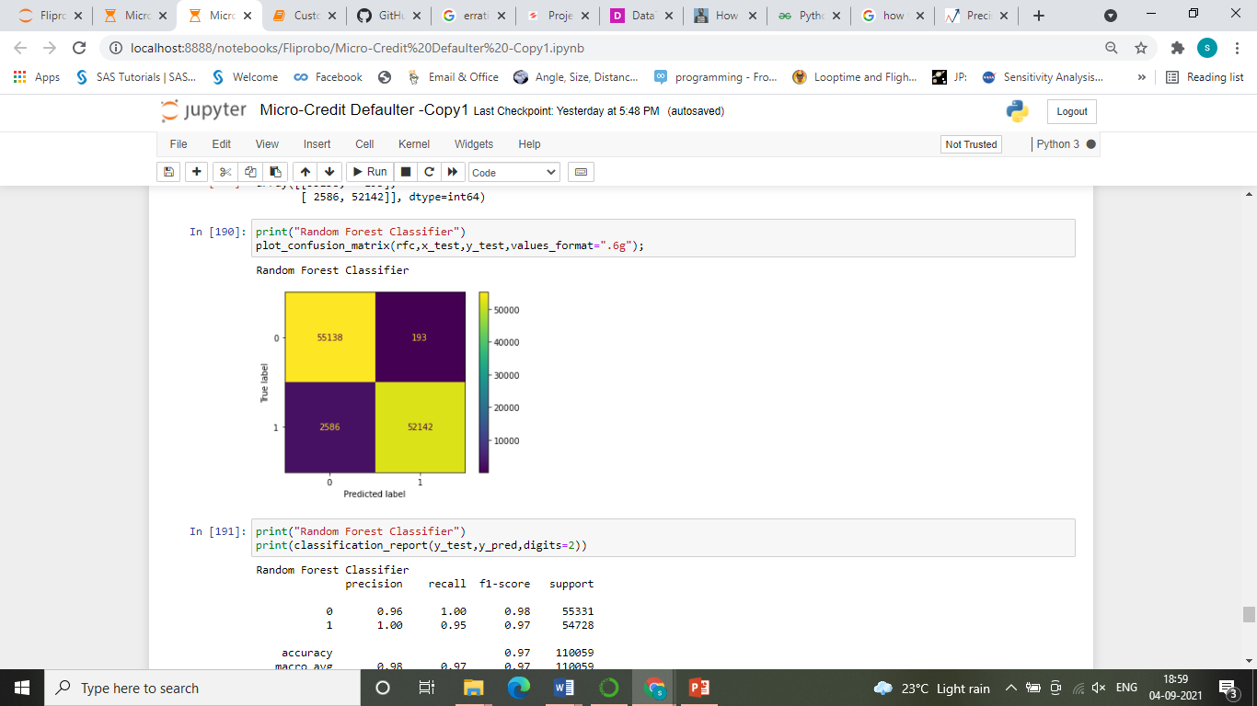
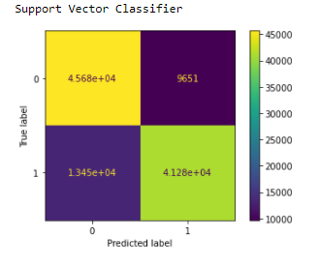
Model Evaluation
Confusion Matrix:

Slide 11
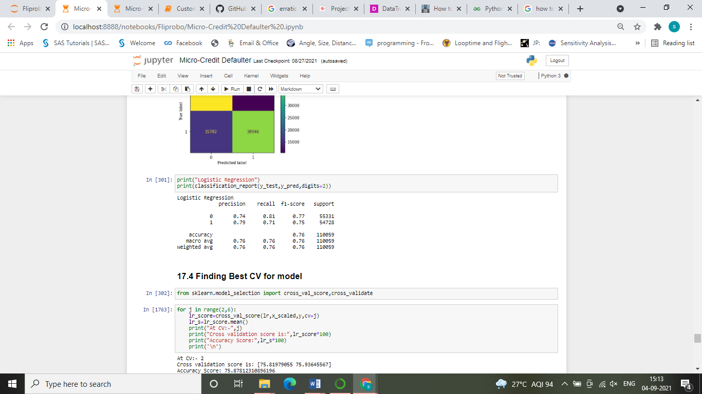
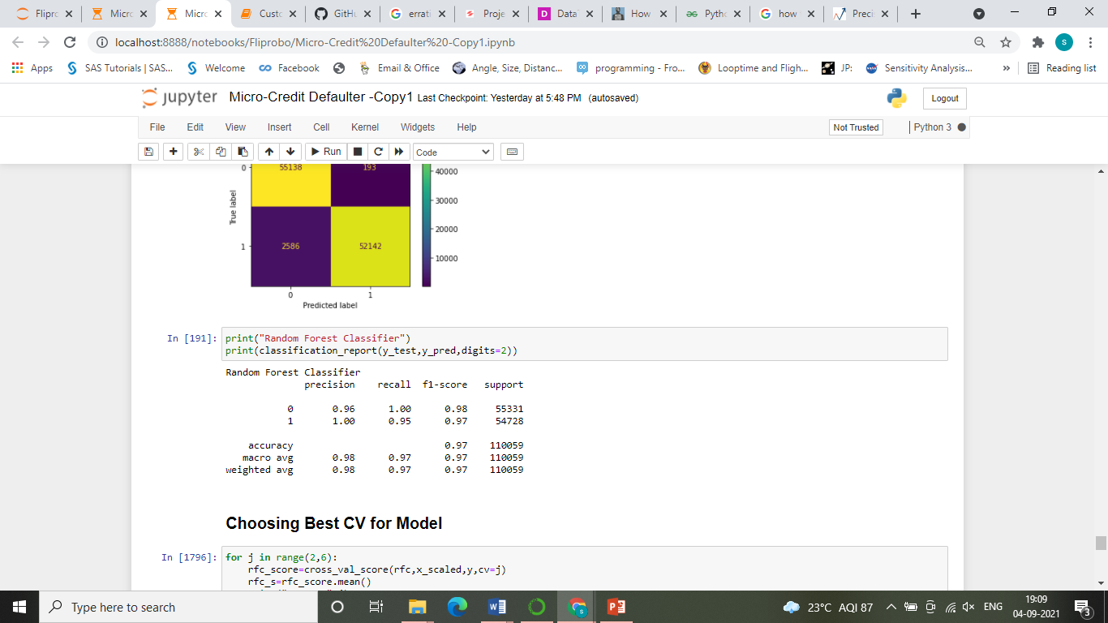
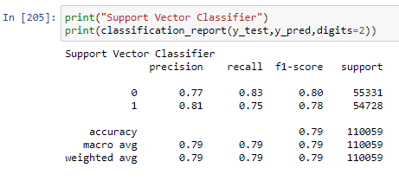
Model Evaluation
Classification Report:

Slide 12
Conclusion
We have shown in Fig 17; Random Forest Classifier is performing better compared to Logistic Regression and Support Vector Classifier.
While doing Principal Components Analysis, as shown in Fig 5 we can go with 7 components to get more than 90% of variance explained.
While doing visual analysis we have got like daily avg spend amount, Avg main account balance, amount recharge, main account recharged, frequency of data account, Avg payback time in days having more impact on candidate’s defaulter.
We have Confirmed that based on AUC ROC Curve Random Forest Classifier is performing better. as shown in Fig 26

Slide 13
THANK YOU

